Slide 1


Case Study
Supermarket Billing System

Slide 2
Objective
The supermarket wants to enhance its operations through data analysis and reporting. The objectives of this system are to:
Track customer purchases and spending patterns.
Monitor product sales and inventory levels.
Evaluate the effectiveness of discounts and promotions.
Analyze category-wise sales performance.
Identify revenue trends and operational bottlenecks.
Through SQL-based analysis, management can make data-driven decisions to improve sales, optimize stock, and enhance customer satisfaction.

Slide 3
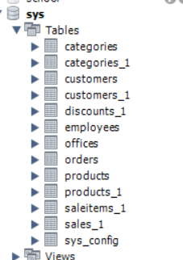
Database Schema
Include:
Customers_1
Products_1
Categories_1
Sales_1
SaleItems_1
Discounts_1

Slide 4

TechStack SQL

Slide 5
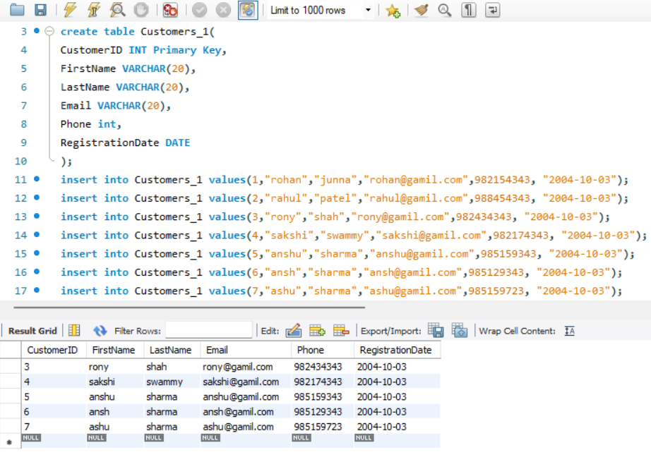
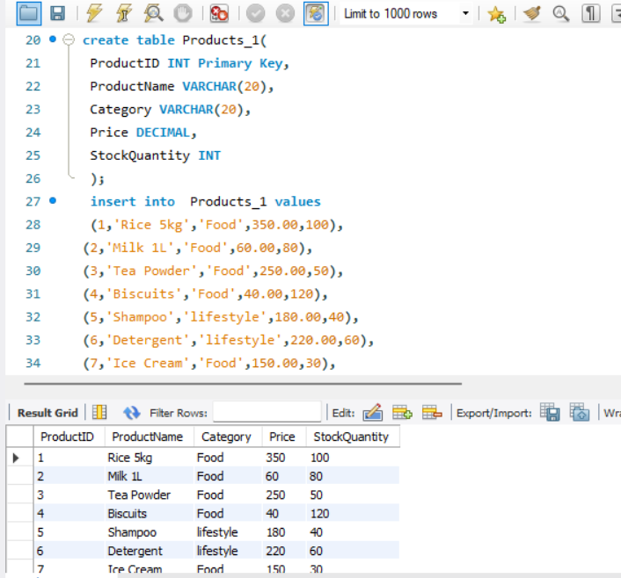
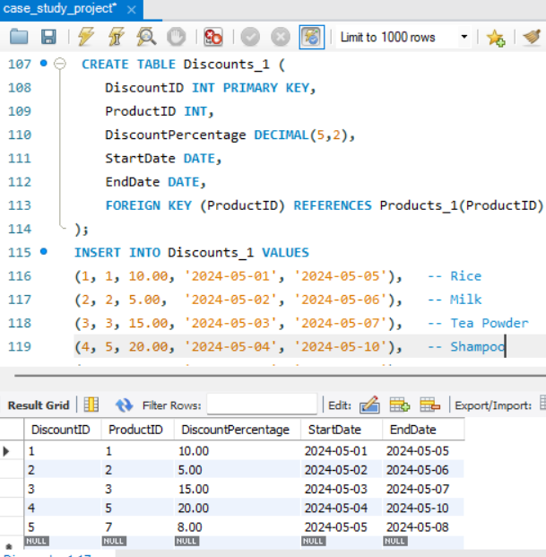
Database Tables
1. Customers_1
2. Products_1
3.Discount_1

Slide 6
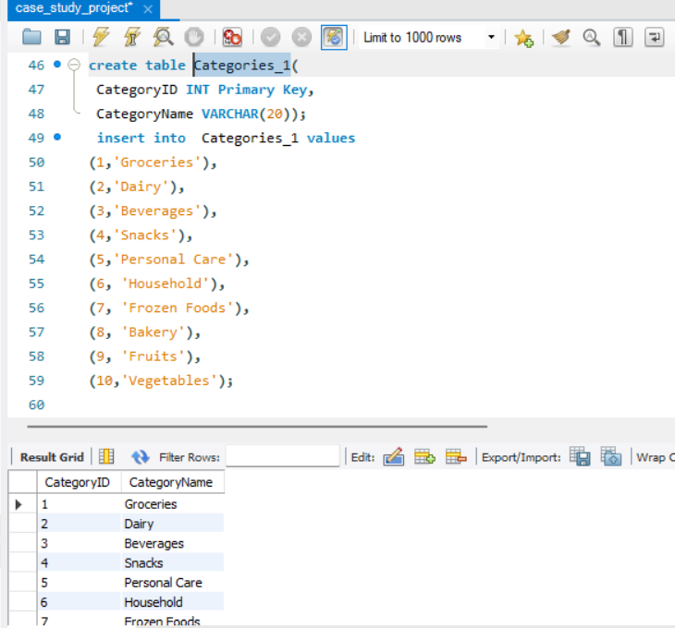
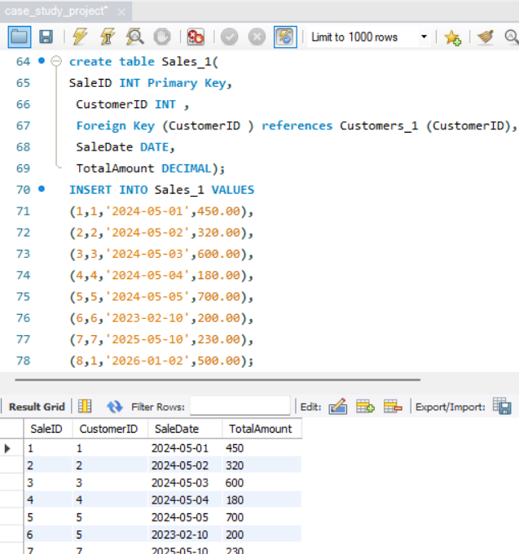
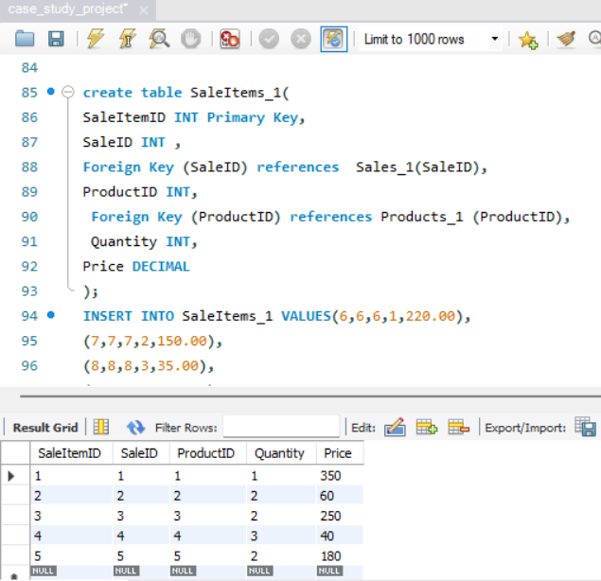
3. Categories_1
4. Sales_1
5.salesItems_1

Slide 7
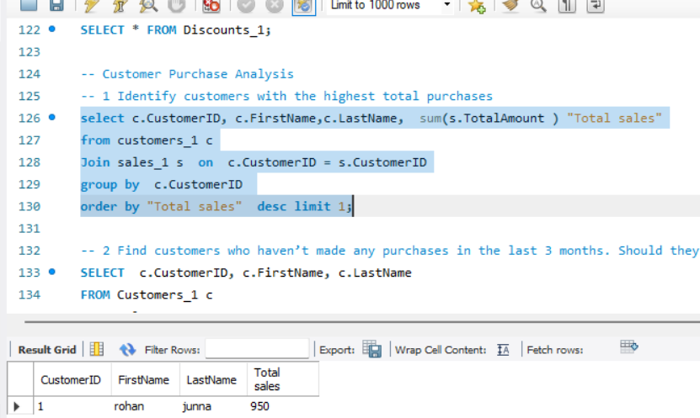
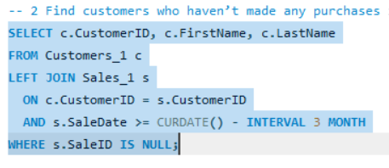
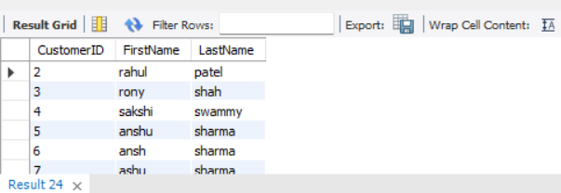
Customer Purchase Analysis
1. Identify customers with the highest total purchases
The customer with the highest total purchase value is identified by summing total sales per customer. This customer contributes the maximum revenue and is considered a high-value customer.
2. Find customers who haven’t made any purchases in the last 3 months. Should they be targeted for re-engagement offers?
They can be targeted with re-engagement offers,
emails, or special discounts to bring them back.

Slide 8
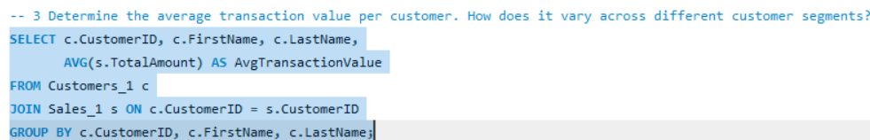
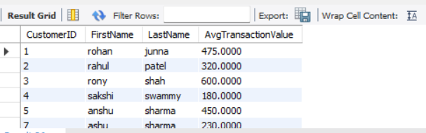
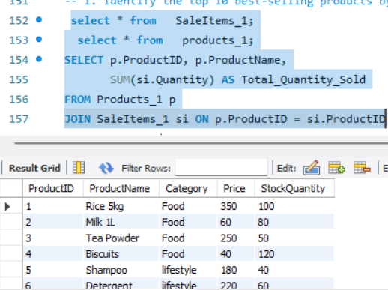
3. Determine the average transaction value per customer.
How does it vary across different customer segments?
Customers with higher averages are premium customers
Helps in customer segmentation (low, medium, high spenders)
Product &amp; Category Performance
1. Identify the top 10 best-selling products by quantity. What makes them popular?

Slide 9
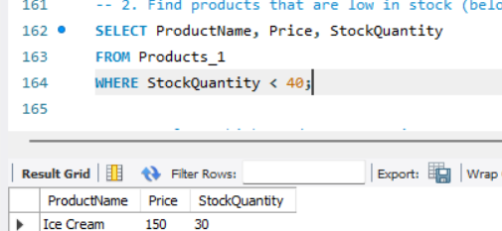
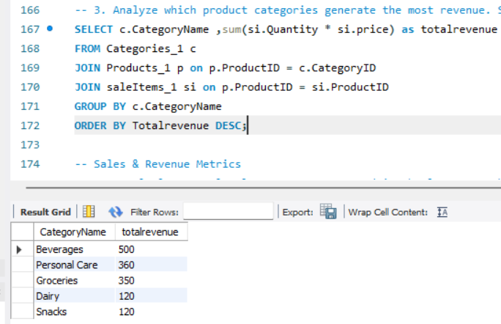
Products with the highest total quantity sold are considered best-selling products.
2. Find products that are low in stock (below a defined threshold). How can inventory be managed proactively?
Prevents loss of sales due to stock-outs
These products require immediate restocking
3. Analyze which product categories generate the most revenue. Should the supermarket expand these categories further?
High-performing categories should be expanded
Add more varieties and offers in these categories

Slide 10
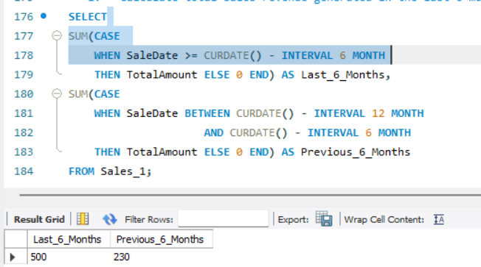
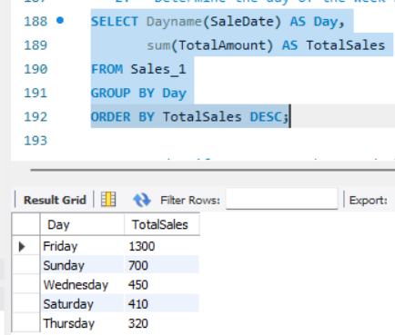
Sales & Revenue Metrics
1. Calculate total sales revenue generated in the last 6 months. How does it compare to the previous 6 months?
Recent 6-month sales show current performance trends
& can be compared with the previous period.
2.Determine the day of the week with the highest sales. How can the supermarket optimize staffing on peak days?
The day with the highest total sales is identified
as the peak sales day.
3. Identify customers who spend above the average transaction amount consistently. Can loyalty programs be tailored to them?

Slide 11
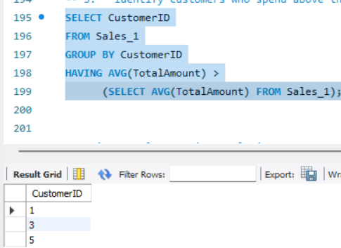
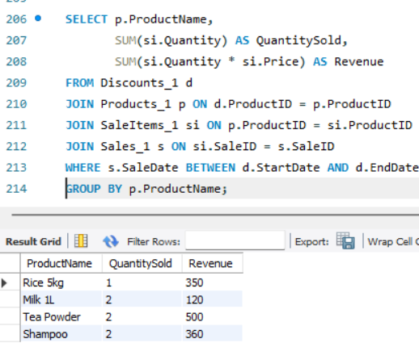
These customers spend more than the overall average transaction value.
Discount & Promotion Analysis
1.Find products that were on discount and their total sales during the discount period. Did discounts increase sales volume?
Effectiveness varies by product
Discounts generally increase sales volume

Slide 12
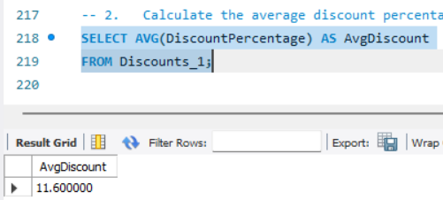
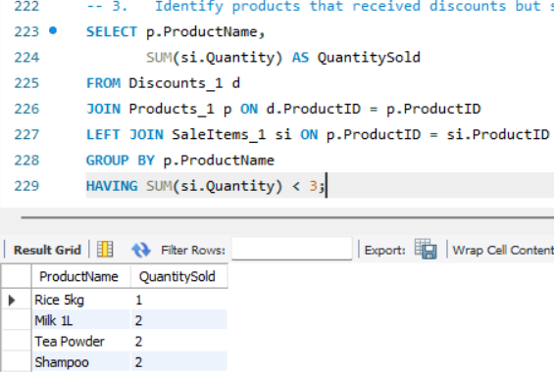
2. Calculate the average discount percentage offered across all products.
How does this affect overall profit margins?
The average discount offered across products gives
an idea of pricing strategy.
3.Identify products that received discounts but still performed poorly. What could be the reason for low sales?
These could be the reasons
Low customer demand
Poor product visibility
High price even after discount
Seasonal products

Slide 13
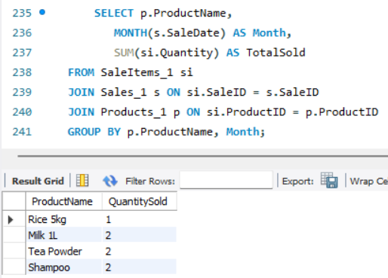
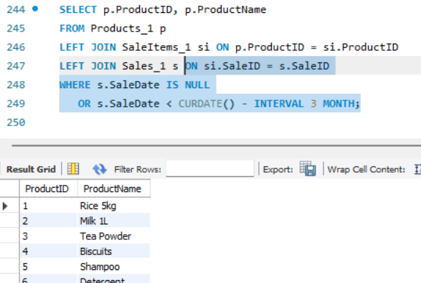
Operational & Inventory Insights
1.Analyze monthly stock usage based on product sales. Which items require frequent restocking?
High-usage products need frequent restocking
Low-usage products may need promotion or removal
2. Identify products that have not been sold in the past 3 months. Should they be discontinued?
Discontinue products
Offer clearance discounts
Replace with better-performing products

Slide 14
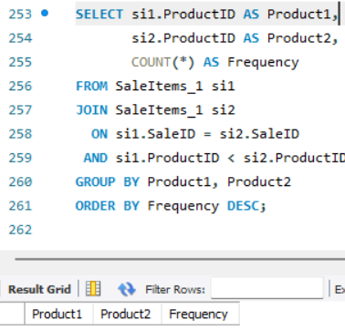
3. Determine the most common combination of items purchased together. Can this be used for combo offers or upselling?
- The query returns no rows because each sale in the dataset contains only one product.
Product combinations require multiple items in a single transaction.
Comparative & Predictive Analysis
Compare sales performance across different product categories. Which category shows the highest growth rate?
Food category dominates
Lifestyle categories perform moderately

Slide 15
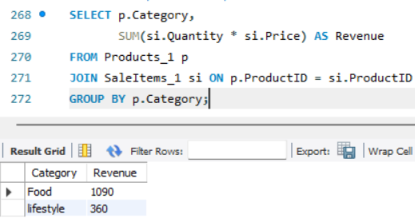
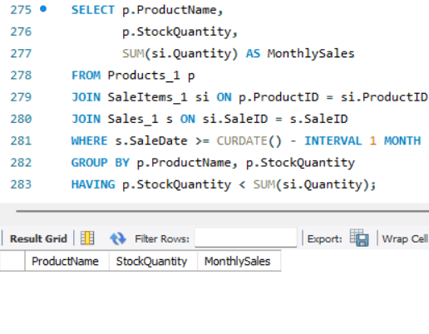
2.Predict which products are likely to run out of stock in the next month based on recent sales trends.
-The query returns no rows because all products have sufficient stock compared to their recent monthly sales.
Hence, no product is currently at risk of running out of stock

Slide 16
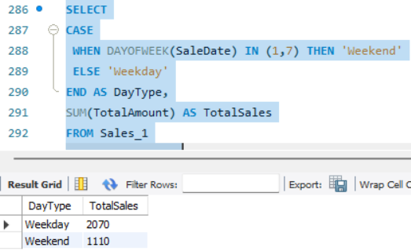
3.Analyze whether customers tend to purchase more during weekends than weekdays.
Should the supermarket adjust pricing or offers accordingly?
Sales are usually higher during weekends.
Run premium offers on weekends
Introduce weekday discounts to balance sales
Summary
This SQL case study demonstrates how structured queries
can convert raw supermarket data into meaningful business insights for better decision-making in sales
inventory, discounts, and customer management.

Slide 17


